Slide 1







Employability Community and Youth Work
Professional skills

Slide 2

Add in page title here…
Fieldwork Placements …
Fieldwork practice is integral to the Community Development and Youth Work, and Youth Studies Programme.
It is essential that students have the opportunity to develop national occupational competences as youth workers and community development practitioners.
It is essential students have the opportunity to develop as informal educators and facilitators of group work, in line with the values and principles that underpin community development and youth work.
The programme provides students with opportunities to relate and develop the connections and relationships between theory and practice through concurrent fieldwork practice experiences: a concept referred to as praxis.

Slide 3

Fieldwork Practice …
BA (Hons) Community Development and Youth Work
(ESB and NYA professionally endorsed)
Fieldwork Placements:
HE4: 190 hrs
HE5: 275 hrs
HE6: 335 hrs
HE6 includes an Action Research Project for your Placement Agency
BA (Hons) Community Development and Youth Studies
Fieldwork Placements:
HE4: 100 hours
HE5: 100 hours
HE6: Dissertation
HE6 - no field work placement
Fieldwork practice creatively challenges and stretche’s students - exposing them to new demands, tasks and roles within an agency environment which provides structured support and is sympathetic to the training and learning needs of students.
Students will be expected to demonstrate they have and can work with a range of projects in appropriate community development and youth work settings

Slide 4

Add in page title here…
What is employability?.
Employability = Q + WE + S x C
Employability = Qualifications + Work Experience + Skills X Contacts
Paul Redmond Hd. of Careers University of Liverpool
Survey of 500 directors across sectors when recruiting, 64% said graduates employability skills were more important than specific occupational, technical or academic skills associated with the graduate’s degree

Slide 5
Add in page title here…
Top skills and abilities
What do you think are the most common skills employers look for?
Teamwork
Problem solving
People Management
Ability to plan and organise
Decision making
Communication skills
Assertiveness and influence
Digital skills
Emotional Intelligence
Critical Thinking

Slide 6
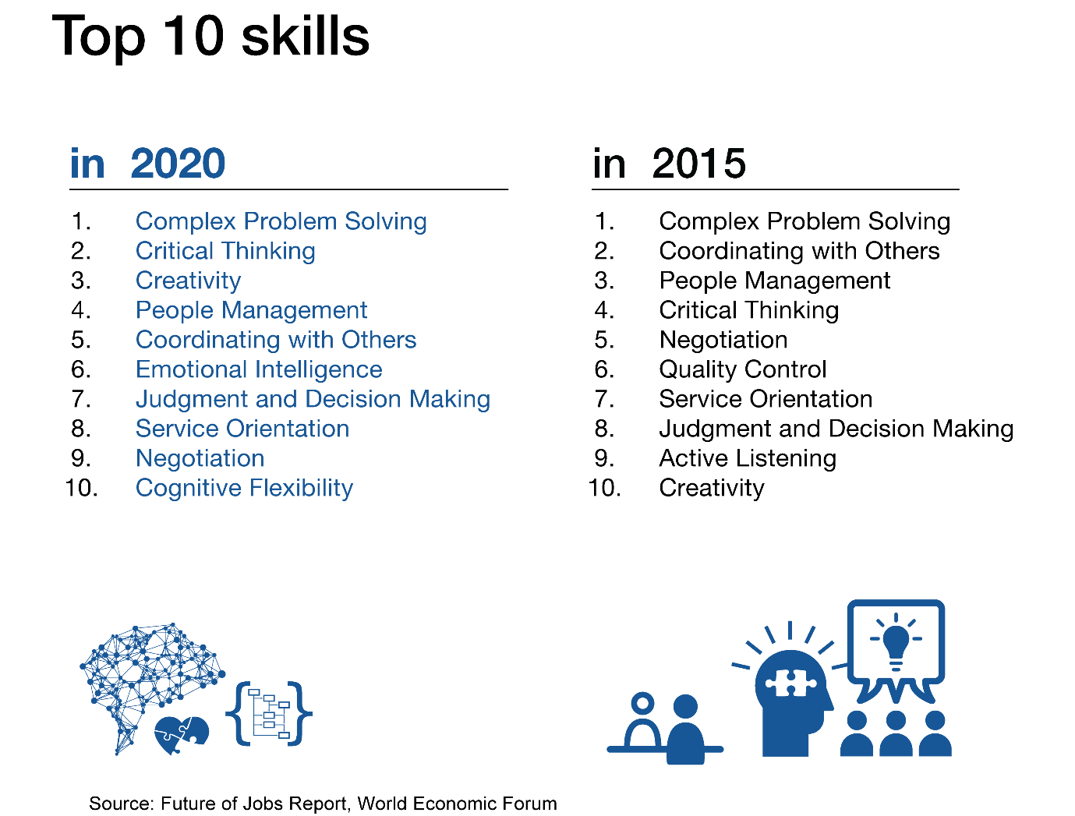
Add in page title here…
Skills needed….
Add in title here…
Add in text here…

Slide 7
Making the most of your placement
Add in page title here…
It is important to remember that any work experience can lead to a job opportunity, you need to set a good impression from the very start – look for opportunities to prove yourself
Prepare – what are your skills and what skills do you need to work on. Make it clear that you are eager to take on extra responsibilities, such as managing your own project
Think about how you can improve the organisation on a micro level e.g. refine a process or improve efficiency (can you offer a solution)
Keep a log of your placement – record tasks, responsibilities and achievements. You can then include this in your CV and covering letter
Seek constructive feedback
Self-reflection

Slide 8
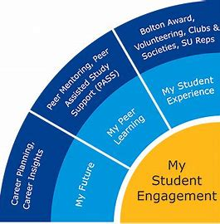





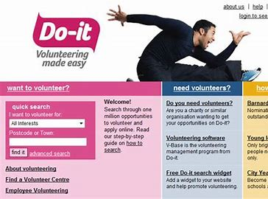


Opportunities at UoB

Slide 9
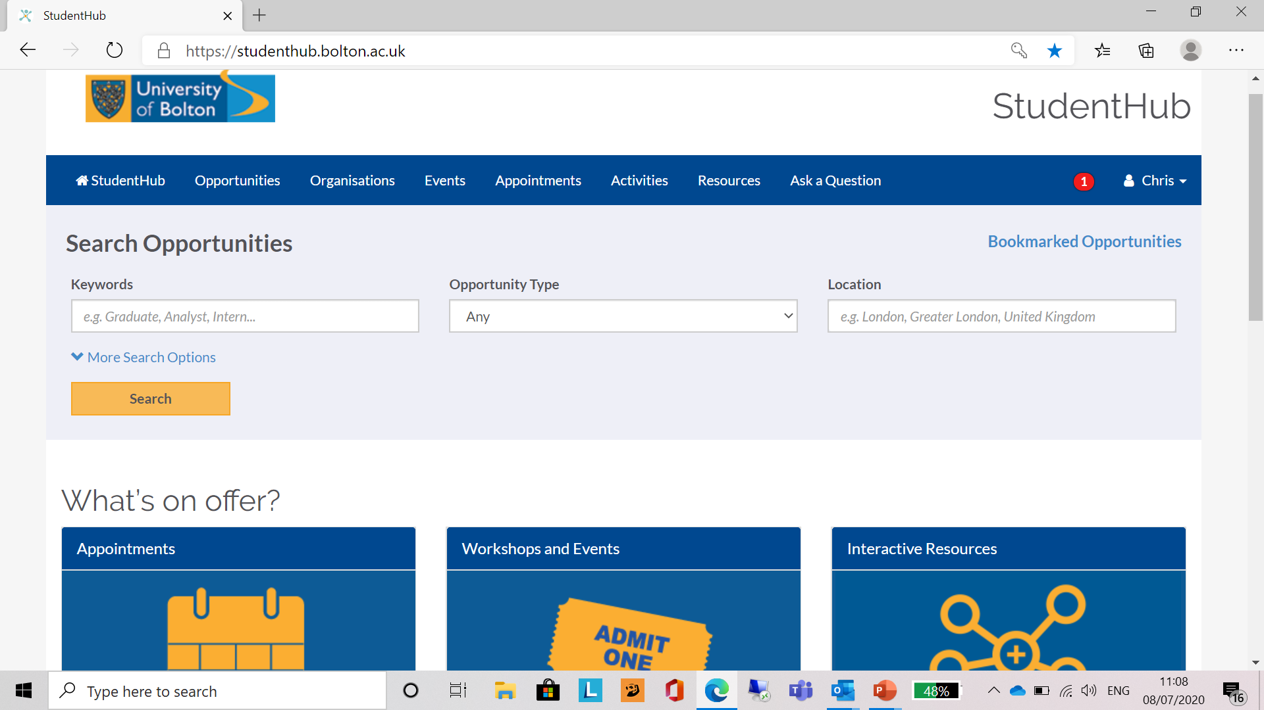
Professional Skills

Slide 10
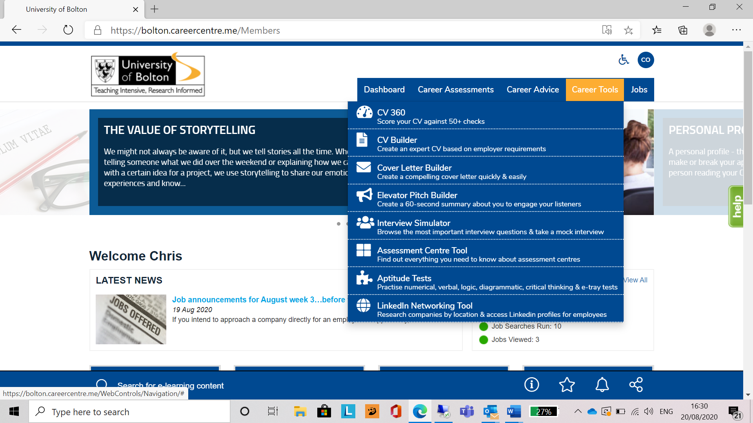
Add in page title here…
Career Tools
Add in title here…

Slide 11
Add in page title here…
Workshops
Your Future in Teaching (Understanding the Routes)
Preparing for the Careers Fair
Considering postgraduate study?
Your Presentation – Tips for Success
Volunteering … How can I get involved?
Preparing for the Careers Fair
Your CV … Quick Fix for CVs and Covering lettershttps://studenthub.bolton.ac.uk/students/events
Your Job Search … How to find and apply for graduate schemes.
Career and Opportunities Fair
Your Interview … Tips for Success
Your Application … How to write effective applications.
Your CV … Quick Fix for CVs and Covering letters
Volunteering … How can I get involved?
Your Job Search … How to find and apply for graduate schemes.
Your Network … Using Social Media to find a job

Slide 12



Add in page title here…
Networks and contacts
LinkedIn Learning
LinkedIn video and handouts
Job/Employer search

Slide 13

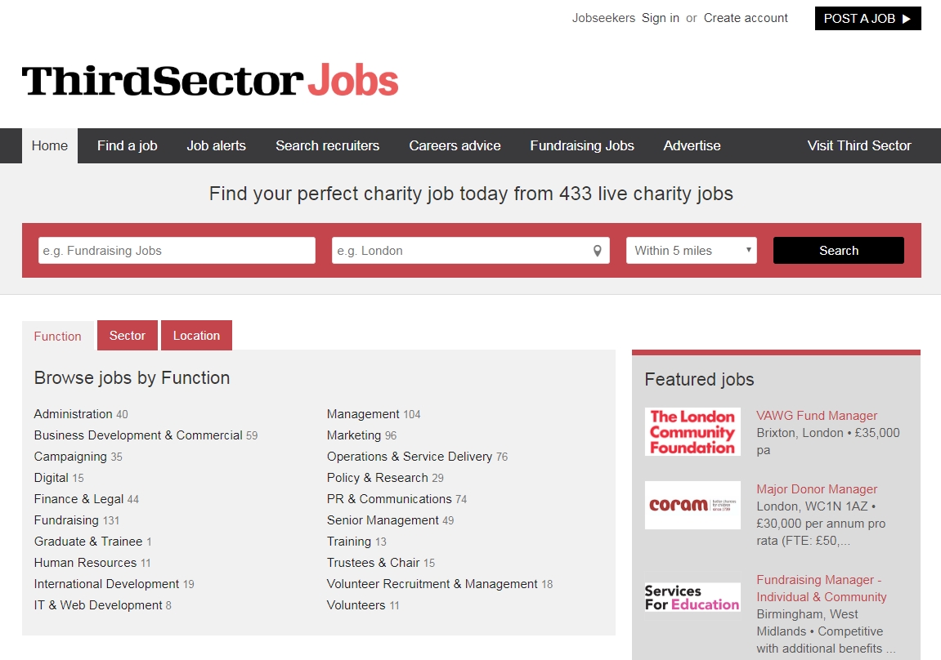

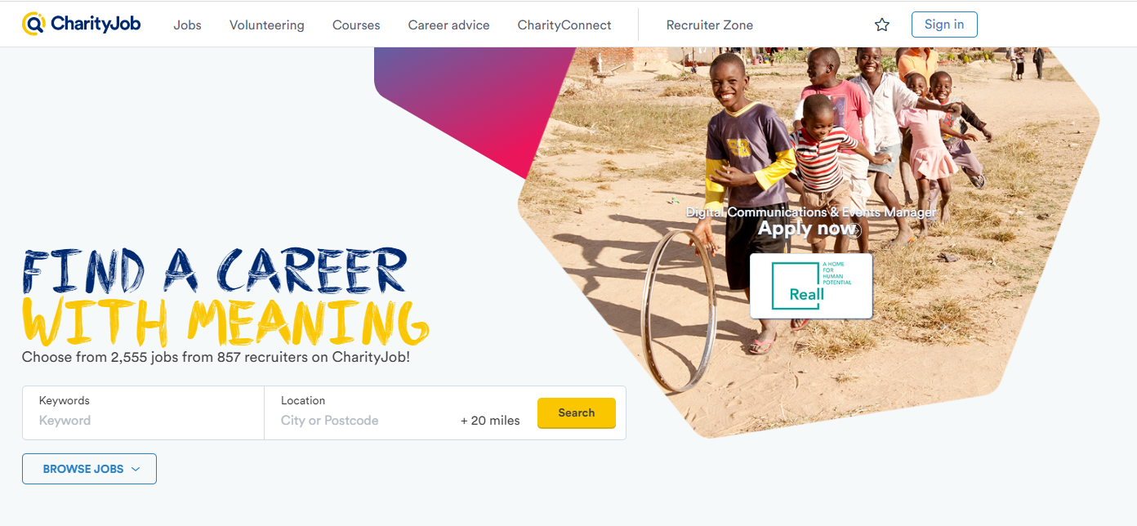


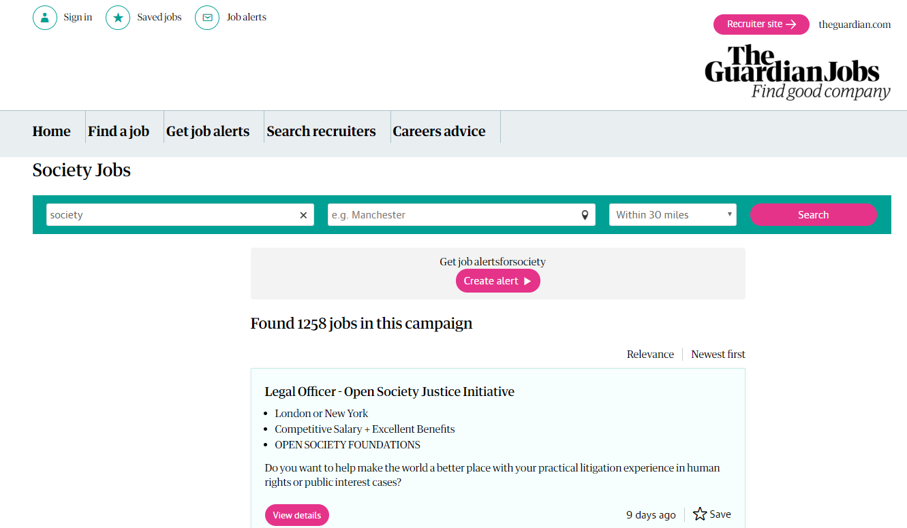



Add in page title here…
Research employers
Local authorities, including the Integrated Youth Support Services (IYSS)
Schools and colleges
Housing associations
Churches and community or faith groups
Drug and alcohol services
Youth Offending Teams (YOTs)

Slide 14

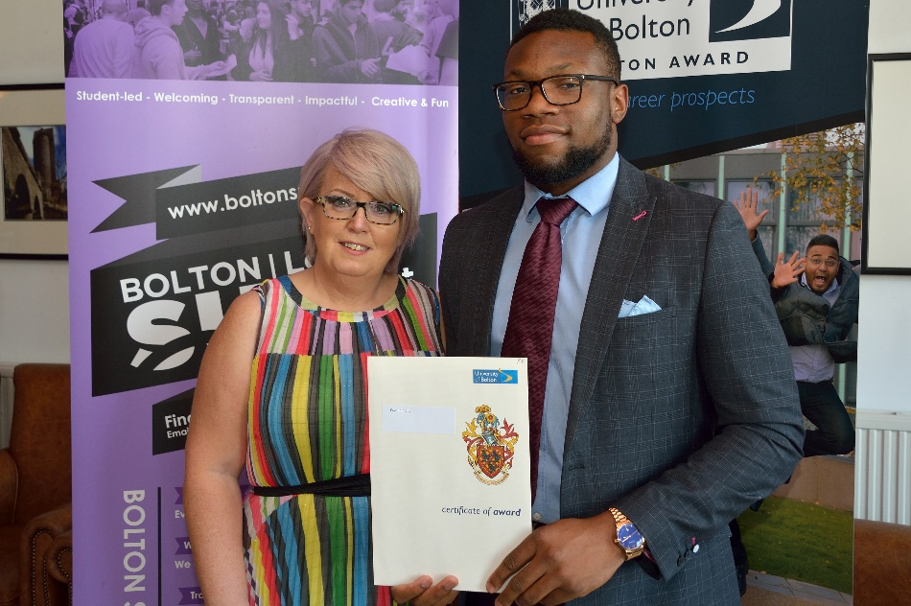
What is the Bolton Award? An employability programme designed to give you work experience and develop soft skills that employers crave. You can start at any time in the year, whether you are a first year undergraduate or a PhD candidate! You can complete it at your own pace. Whether it takes three months or three years, it's your choice!

Slide 15

Add in page title here…
Additional Benefits
Earn £50 in your second year and £75 in your third year if you complete the Bolton Award!
Helps you to explore your personal career goals and develop crucial employability skills
Boosts your CV
Gives credit to all of the work you are currently doing!
Telephone: 01204 903423
Email: BoltonAward@bolton.ac.uk

Slide 16
Some positives for the future
Many jobs people said could not be done from home, will be proven they can be
Flexible working will be seen and appreciated as equally valuable
Less need to travel for work, giving people more time and have a huge positive environmental impact
We all notice and take more care of one another’s physical and mental health and well-being
We all recognise the value of our time, work more effectively and create time for the things that really matter to us
The value of careers will be re-evaluated according to their value to society, rather than by simple financial return
We will be more thankful for the things many took for granted like income, job security or annual leave
We will be more kind and understanding that whilst work is an important and meaningful part of life, it is only one part of it

Slide 17

Add in page title here…
What can I do?
Register with Studenthub
Update contact details after graduation
https://studenthub.bolton.ac.uk/students/login?ReturnUrl=%2f
https://www.youtube.com/watch?v=Jgf1HxlIZFs
What can I do with my degree?
Bolton Award - Bulletin
Register with relevant Recruitment Agencies
Support from the Careers Team
LinkedIn
Research Youth and Community sector

Slide 18

Make Contact
Add in page title here…
Careers Service
Tel: 01204 903080
Studenthub:
Access Full & Part Time Vacancies, Work Experience Opportunities, Book Careers Appointments and book onto workshops. Look at up and coming events!!
Connect with us on LinkedIn: Careers Service The University of Bolton
Email: studenthub-careers@bolton.ac.uk

